Slide 1

Design and analysis of hospital record management system.
TEAM:
MIR SHUJATH ALI
K. VENKAT GANESH
K. SHRAVANI
Y.ROHITH KUMAR
Guided by:
DR.B.SANJAI PRASADA RAO

Slide 2
OUTLINE
Introduction
Objective & Motivation
Hardware & Software Requirements
Responsibilities
Flow chart
Block diagram
Implementation screenshots
Challenges
Limitations & Future Enhancement
Time plan for the project
References

Slide 3
INTRODUCTION
The Hospital Management System(HMS) is designed for any hospital to replace their existing manual, paper based system. This system targets to provide complete solution for Hospital and Health care services.
This system can be used in any hospital, clinic diagonstics or Pathology labs for maintaining patient details and their test results.
It integrates the entire Resources of a hospital into one integrated software application.

Slide 4
FEATURES Useful for 1. Large, medium hospitals and nursing homes 2. Physicians, Surgeons, Gynaecologist
Benefits:
Its huge time saver and really facilities proper communications among the management, staff and the patier parties.
Daily collection report
Minimize our repeated works and take care of the complete functionality of your hospital.
To find the barriers in implementing EHRs

Slide 5
PROJECT REQUIREMENTS
Operating Systems:
Windows XP & above
Windows 7
Database:
SQL SERVER
S/W applications:
Brackets
Languages:
HTML ,CSS,BASICS OF JAVA SCRIPT

Slide 6

Logical Database Designing

Slide 7
FLOWCHART
START
REQUIREMENTS
REQUIREMENT
ANALYSIS
ANALYSIS
IDENTIFICATION AND SPECIFICATION.
SYSTEM ACHITECTURE
END

Slide 8
BLOCK DIAGRAM
Patient
Register, bill
Authenticate
Process
HMS
Treatment
Administrator
Records
Payroll
Duty
Staff

Slide 9
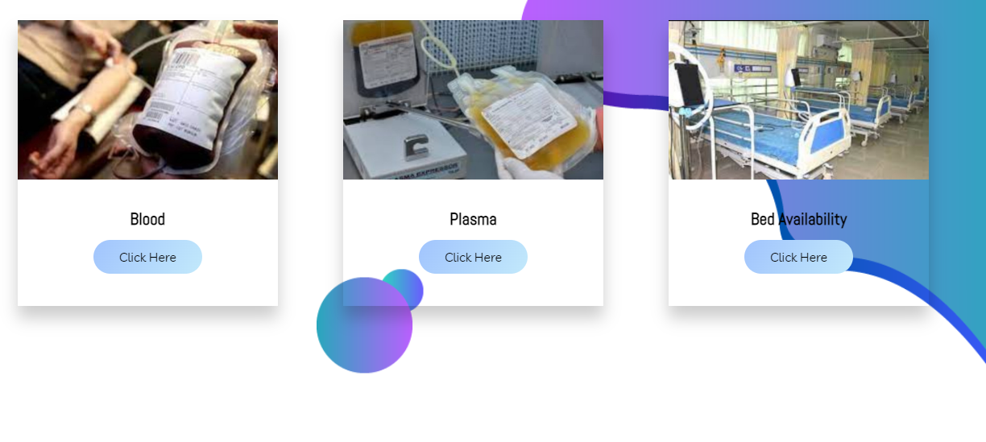
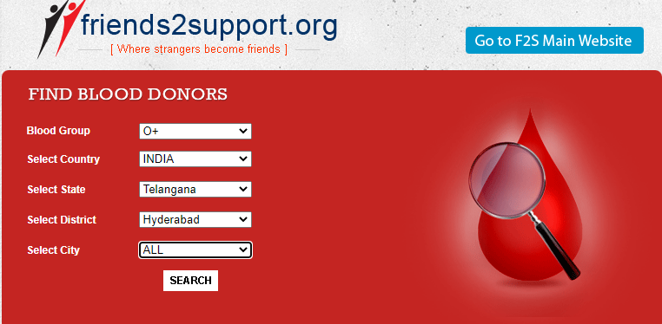
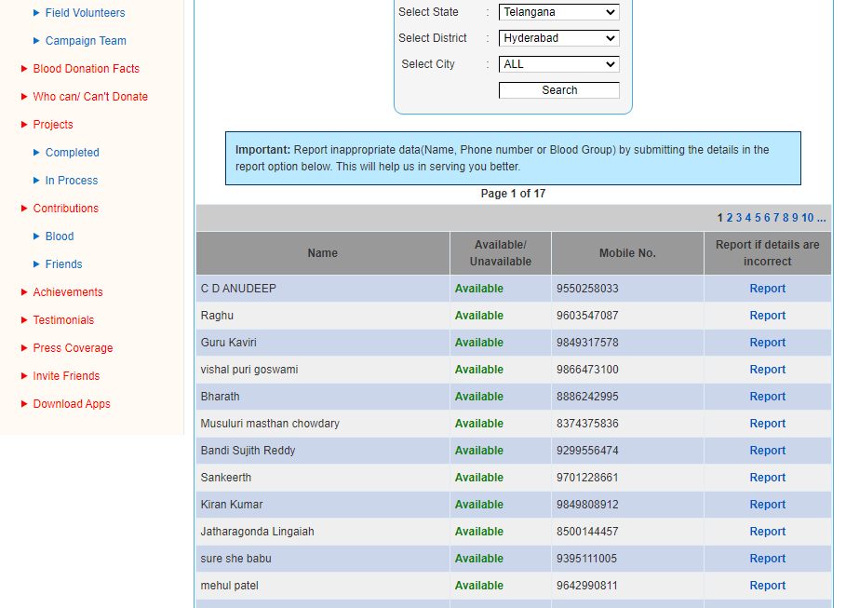
Screenshots

Slide 10

Challenges
Most of the hospitals in India must use HMS, but they face particular challenges in implementing it. Among them, technical and human challenges are the complicated factors while implementing HMS.
Human Challenges
Awareness of HMS's advantages & importance.
Experience and knowledge of using computer applications.
Impressions and Beliefs regarding HMS and making use of them efficiently.
Technical Challenges:
Networks and computers have different maintenance problems.
Lack of standards for Data entry and retrieval.

Slide 11
Limitations
Geographical location:
In the state only four places were selected, one from each administrative region based on highest number of bedded hospitals. In absence of getting permission from any one of these chosen hospitals similar hospital was chosen from HYDERABAD and not any other hospital in that region.
Data Analysis
System Integrations
Scalability, Security, and Transaction Management.
FUTURE ENHANCEMENTS
the proposed system is Hospital Management System. We can enhance this system by including more facilities like pharmacy system for the stock details of medicines in the pharmacy. Providing such features enable the users to include more comments into the system.

Slide 12
TIME PLAN FOR THE PROJECT
Project Effort and Time we developed had given about 6-8 hours per week to make this project.
Roles and Responsibilities we had worked effectively and have undertaken the following tasks:
•Researching in the related field of Diseases.
•Researching in the related field of Blood & Plasma.
•Researching in the related field of Hospitals and treatments.
•Researching in the related field of pharmacetual and medicine

Slide 13
REFERENCES:
https://www.researchgate.net/deref/http%3A%2F%2Fsearch.informit.com.au%2FdocumentSummary%3Bdn%3D445704802911875%3Bres%3DIELHEA
The Complete 2022 Web Development Bootcamp | Udemy
How to Create Patient Record Management System – YouTube
Hospital Management System software Video – YouTube
Hospitals | Must Watch | Purushotam Academy - YouTube
Health Information Management Made Simple | Ciox - YouTube

Slide 14
CONCLUSION
The project HMS is for computerizing the working in a hospital. The software takes care of all the requirements of an average hospital and is capable to provide easy and effective storage of information related to patients that come up to the hospital.
It also provides injection details, blood & plasma details and billing facility
The system also provides the facility of backup as per the requirement.

Slide 15

THANK YOU

